Slide 2
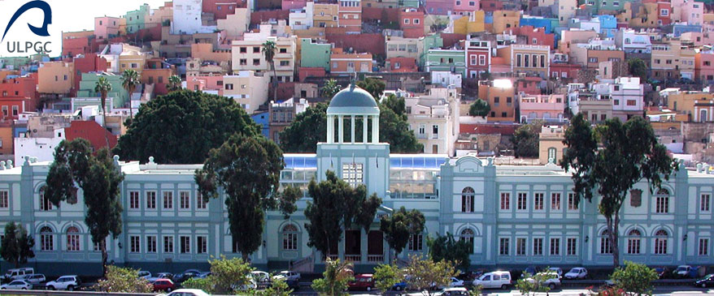
Congratulations

Slide 3
Decades of social and popular claims for University Studies in
Gran Canaria
.
.
.
1968-69 Industrial Engineering and Architecture High Technical Schools (Dep. of La Laguna)
University College (3 years) of Medicine (Dep. Univ of La Laguna)
Other Divisions in the College
Polytechnic University of Las Palmas
Industrial Engineering and Architecture High Technical Schools
Faculty of Informatics
High Technical School of Telecommunications
Marine Sciences
1989
Full University , Universidad de Las Palmas de Gran Canaria
(Reorganization of the University “space” in the Islands)

Slide 4
1989
Universidad de las Palmas de Gran Canaria
36 University Depts
14 Faculties
4 High Technical Schools
11 University Research and Development Institutes
(4 of them related to Information and Communication Techs)
More than 25.000 students
2019
Eurocast’89
Eurocast 2019
Congratulations and many Thanks

Slide 5
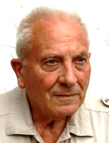
Before entering Eurocast 2019,
sad news
Our friend, distinguished Professor Rudolph Albrecht,
organizer and General Chairman of Eurocast ‘95 Insbruck
is no longer among us. He passed away less than two weeks ago.
Eurocast 2019, to Prof. Rudolph Albrecht
IN MEMORIAM

Slide 6
Pichler
Albrecht
Moreno-Díaz
2009 Eurocast 20 years Gáldar

Slide 7
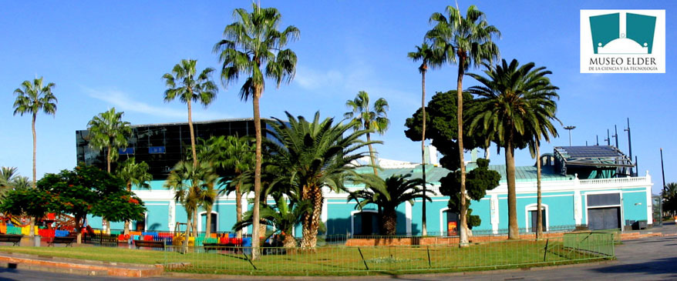
Eurocast 2019 – 30 years

Slide 8
Aims of eurocast
To be a multidisciplinary, flexible and changing conference, trying to attract the experts and especially young researchers, facilitating the interaction between them, which is a generator of creativity.
We first acknowledge the Creative Agents of each eurocast Conference, wich are
The WORKSHOP CHAIRPERSONS
They have proposed the Workshops, define their content, spread the information on the Conference, and promote and encourage participation.
Later, they select among intended participants. Finally, they shall stablish ranks to help selection for the Springer publication

Slide 9
Therefore, Many Thanks to:
Rudolf
Amalia e Antonio
Michael A., Stefan und Günter
Jan, Milan et Itsushi
Mario, Bernhard, Michael L., und Werner
Javi, Javier, Eleni, Fernando, Cristina und Leopoldo
Manolo P., Petia y Marcos
Jerzy, Manolo M. and Ryszard
Pepe, Abrahán y Roberto jr
Dirk, Ranier und Erich
Sándor, Mario(again), Peter und Carl
Practically all have been with us for many years!!
Gratitude to our plenary lecturers
Prof. Paul Cull
Prof. Christoph Stiller
Prof. Bruno Buchberger
12 Workshops, 138 Selected Contributions
And then, we must acknowledge the MAIN ACTORS, without which no Conference is possible
The Participants
For the quality of your contributions

Slide 10
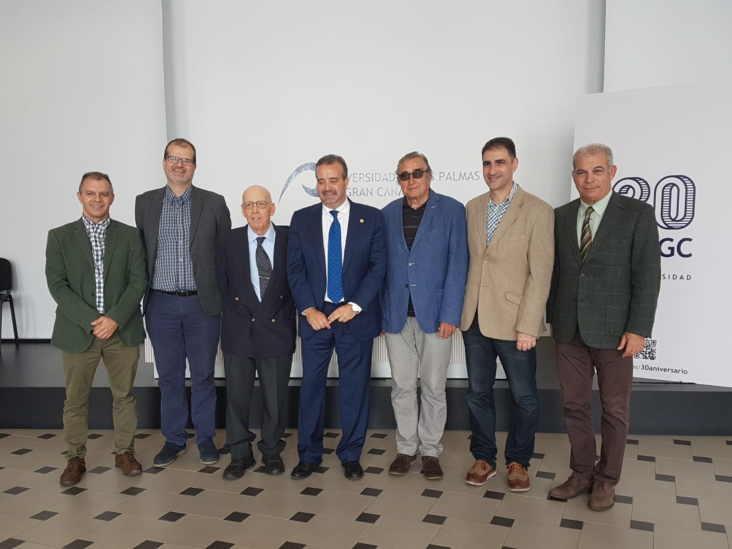
Presentation of Eurocast 2019-30years
in the University Institutional Building
November 2018

Slide 11
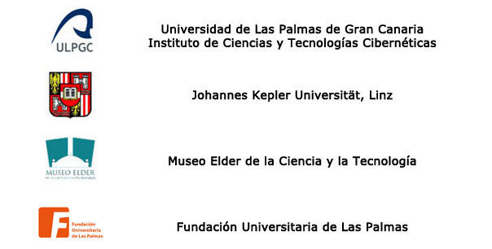
And now, we have to express our Deep Gratitude to the four engines behind Eurocast
Home of Eurocast
To the sponsors
And to the nominal sponsor

Slide 12
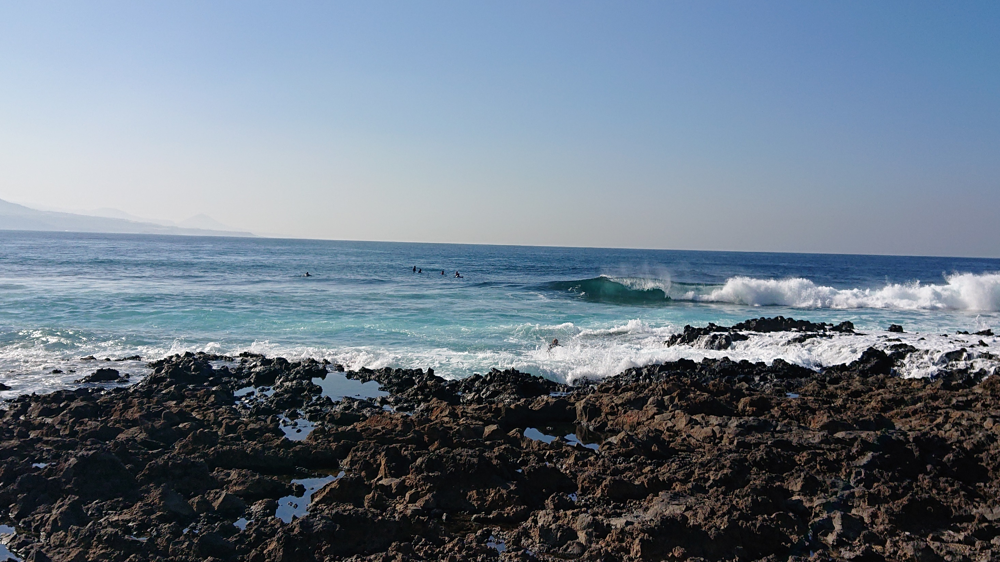
Welcome to Eurocast 2019-30years !

